Slide 1
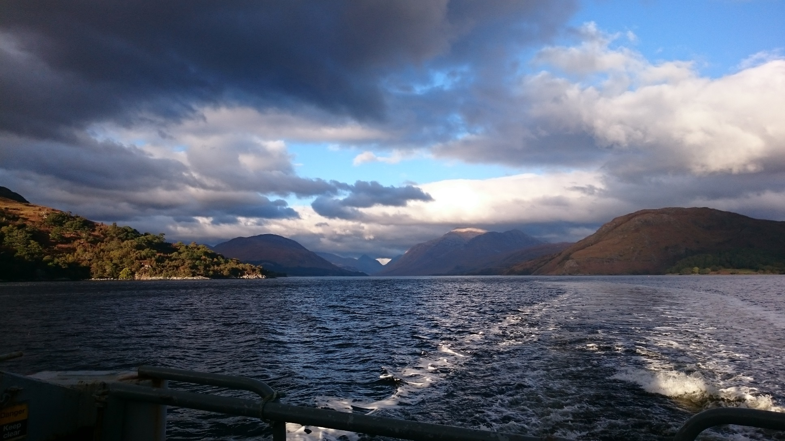
H1 Marine Science Easter Field Trip

Slide 2
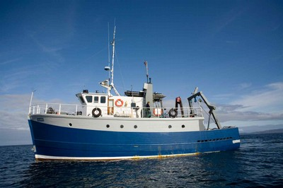
Research Vessel Calanus

Slide 3
What you will need:
Water proof boots or wellies
Water proof jacket
Water proof/resistant trousers
Warm clothes including a hat
Warm gloves
Notebook & pencils (not pens – not much use in the wet)
(or does everyone have a smart phone now?)
Its good to have:
Camera – pictures always look good in reports
(or does everyone have a smart phone now?)

Slide 4
Food
Food is provided on Calanus (you are on it all day)
Email me: tim.brand@sams.ac.uk if you have
dietary requirements, e.g. vegetarian, vegan,
But if you have allergies (nuts, lactose, etc.) please bring your own food

Slide 5
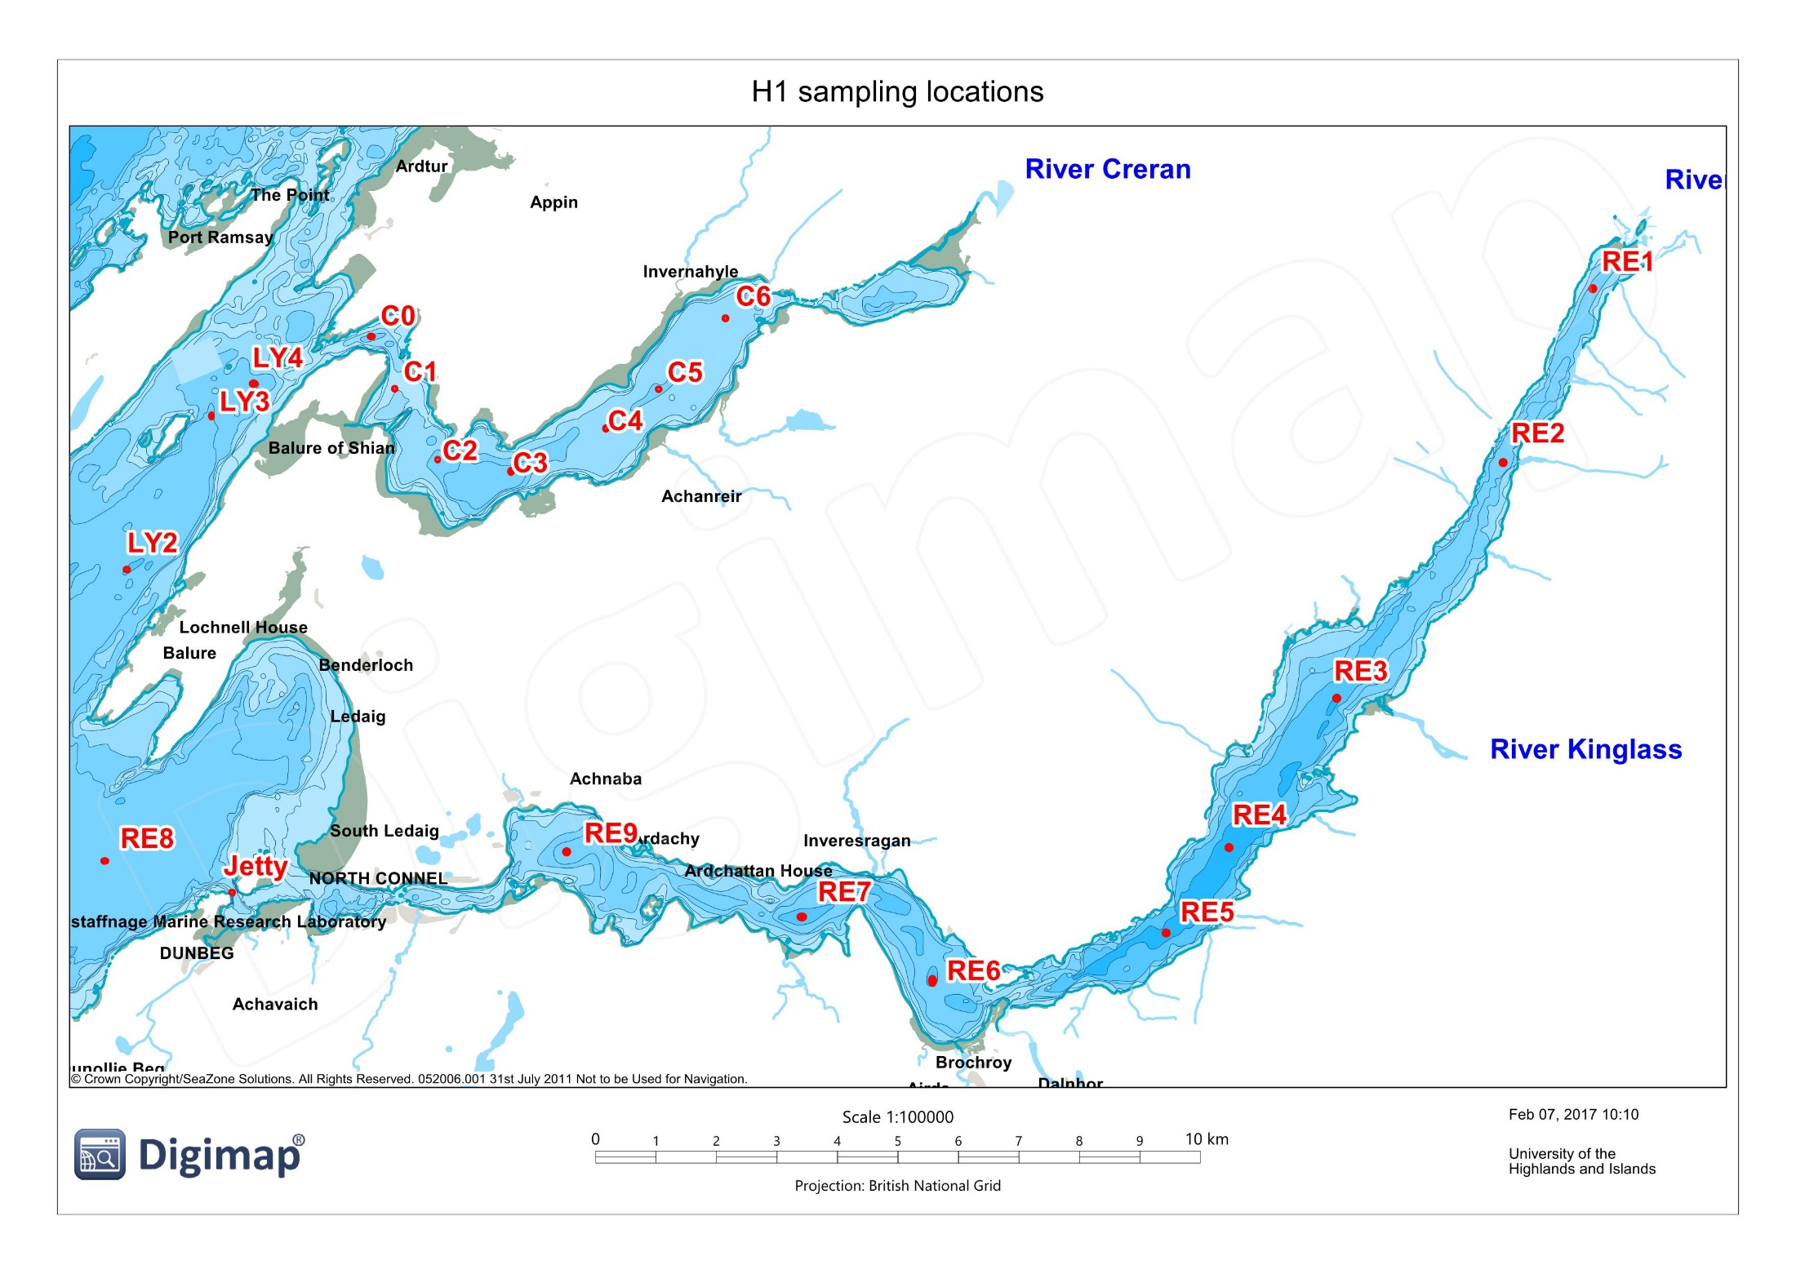
Loch Creran
Fishing area
Loch Etive

Slide 6
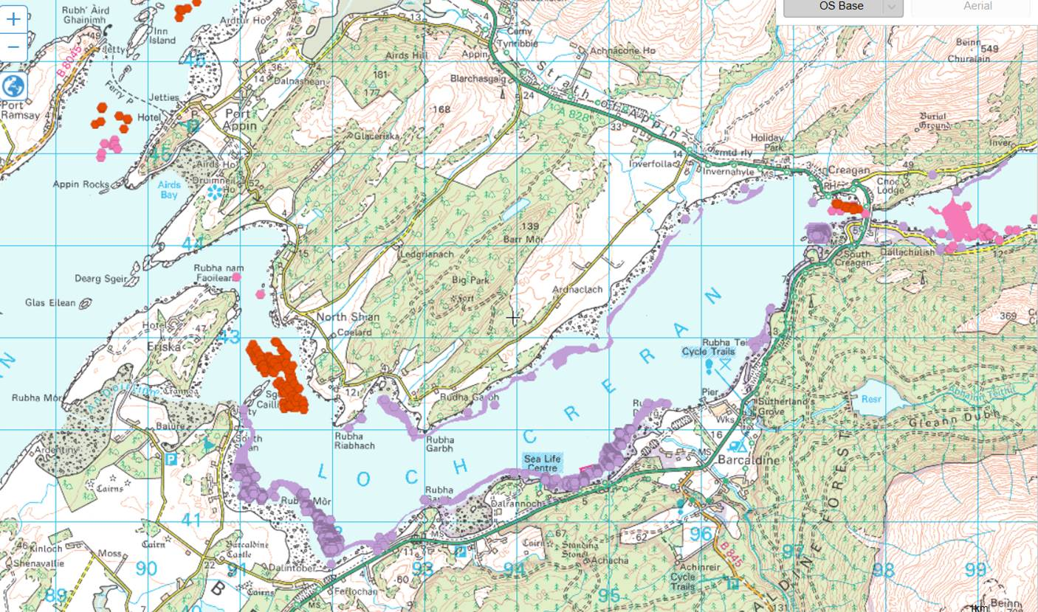
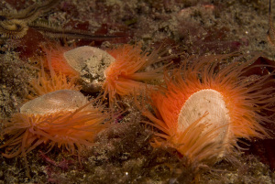
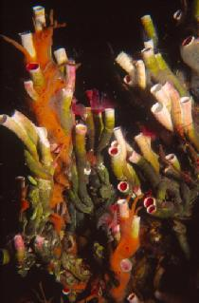
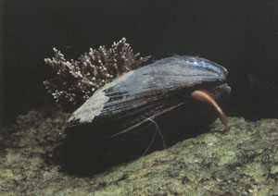
Loch Creran is a Special Area of Conservation, SAC
Flame shell beds
Serpulid worm reefs
Horse mussels

Slide 7
Weather warning
The captain of Calanus, Norman Smith, will decide on which day we go to which area.
Loch Etive is the most ‘protected’ site, the Firth of Lorn is the least
If we have strong winds for all 4 days we will go into Loch Etive each day

Slide 8
Flatfish (benthic dwelling) biology in Ardmucknish Bay
Aims of field work and practical
To provide an introduction to the methods used to collect
benthic fish samples
To gain experience in identification of the major animal
groups found in seabed sediments (fish and invertebrates)
To illustrate the links between faunal community structure, sediment type and hydrography in the area

Slide 9
Benthic faunal biology
Comparison of benthic fauna in bottom sediments of Loch Etive, Loch Creran and the Firth of Lorn
Aims of field work and practical
To provide an introduction to the methods used to collect
and preserve benthic faunal samples
To gain experience in identification of the major animal
groups found in seabed sediments
To illustrate the links between faunal community structure and sediment type of two areas

Slide 10
Hydrography
Determination of the ‘physical’ properties of the water in Loch Etive,
Aims of field work and practical
To understand how a CTD (conductivity, temperature, depth profiler) works.
To determine the temperature and salinity of the water of the area and understand how these affect its density
To understand the different ‘forcings’ affecting water movement in the area, (wind, tide, local density differences)

Slide 11
Plankton biology
Determination of phytoplankton and zooplankton organisms within Dunstaffnage Bay and Firth of Lorn
Aims of field work and practical
To gain experience in the collection of phytoplankton and zooplankton samples and their processing for subsequent analysis.
To observe and identify different phytoplankton.
To observe and identify different zooplankton

Slide 12
Chemistry
Determination of the Phosphate and Chlorophyll A concentrations in Loch Etive
Aims of field work and practical
To determine the concentration of dissolved phosphate in Loch Etive using spectrophotometry.
To determine the concentration of Chlorophyll A in Loch Etive using fluorescence.
To understand the link between chemistry and hydrography (physics) in the area
To understand the link between the chemistry and the phytoplankton (chlorophyll)

Slide 13
Sea lochs
Sea lochs are glacially carved valleys that were eroded during the last Ice Age, 2m to 10k years ago, (also known as the Pleistocene geological period)
They join the sea (otherwise they would just be called ‘lochs’)
Since 10 000 years ago and the melting of the ice they have subsequently been flooded by the rising sea level.

Slide 15
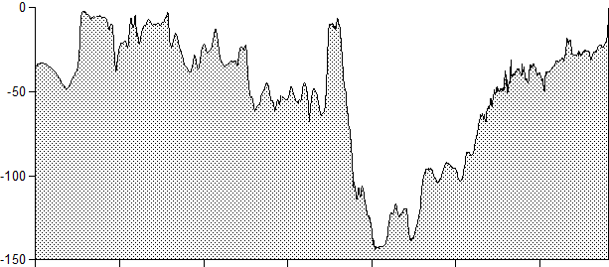
River inputs into Loch Etive
River Awe
River Kinglass
River Etive
Depth (m)
0 10 20 30
(km)

Slide 16
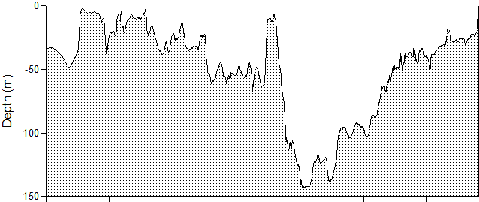
Incoming marine tidal water
Fresh water
No circulation
0 10 20 30
(km)
Incoming tidal marine water is progressively ‘freshened’ as it floods into
the Loch, reducing its density along the way

Slide 17
No circulation
0 10 20 30
(km)
As fresh water runoff reduces, the density of the incoming tidal allows it to
penetrate deeper into the upper basin

Slide 18
0 10 20 30
(km)
After a prolonged period of dry weather, the incoming tidal is able to flush
the upper basin completely. On average this occurs every 16 months

